Slide 1
What is Reformed Theology?
It’s Bigger Than You Might Think

Slide 2
Introduction

Slide 3
Correcting False stereotypes
Reformed theology is NOT an innovation; it is an ancient faith
Reformed theology is NOT a cult; it is thoroughly orthodox
Reformed theology is NOT proof-texting; it is thoroughly biblical
Reformed theology is NOT Calvinism; it is much broader and deeper
Reformed theology is NOT only about election / predestination or God’s sovereignty; it is much richer
Reformed theology is NOT a denomination; it is a greater category than ecclesiology

Slide 4
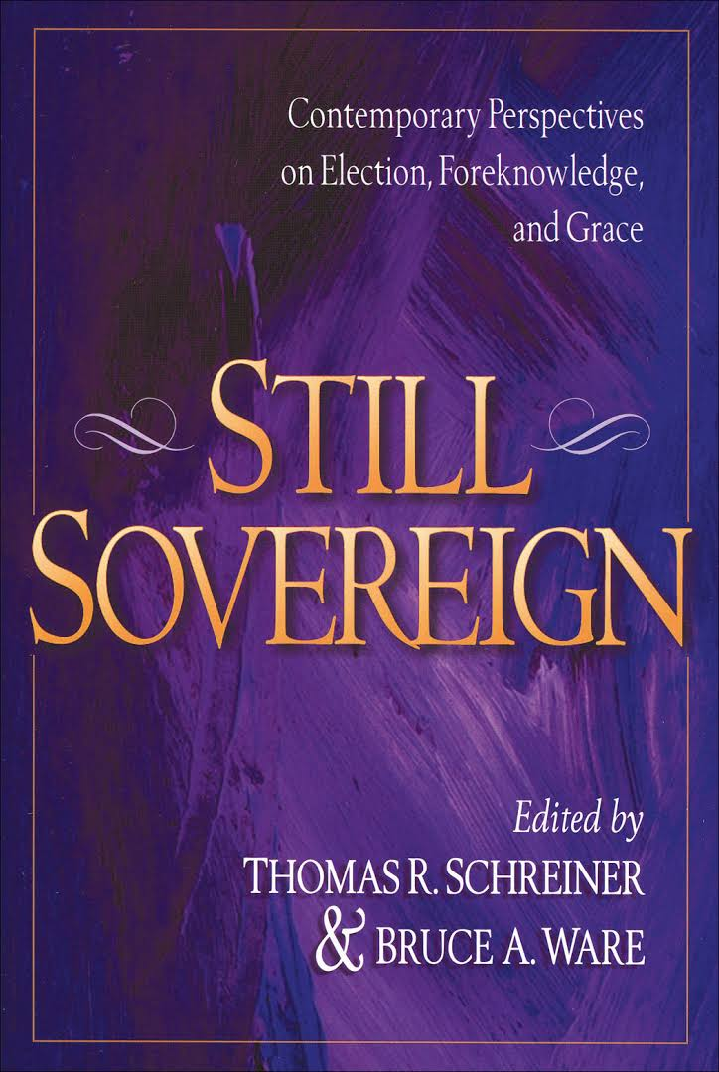
Why be Reformed?
Calvinism ought to be defended not because of its inherent logic, symmetry, or comprehensive structure per se, but because the substance of its biblical understanding is more compelling than that of its rivals.”
Bruce Ware, Still Sovereign, 204

Slide 5
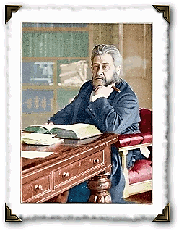
Why be Reformed?
“…what is the heresy of Arminianism but the addition of something to the work of the Redeemer? Every heresy, if brought to the touchstone, will discover itself here. I have my own private opinion that there is no such thing as preaching Christ and Him crucified, unless we preach what nowadays is called Calvinism. It is a nickname to call it Calvinism; Calvinism is the gospel, and nothing else”
Charles Spurgeon

Slide 6
What is Reformed Theology?
It’s Bigger Than You Might Think

Slide 7
Introduction:
The Pillars of Reformed Theology
Covenant Theology
The five sola’s of the Reformation – Grace alone, Faith alone, Christ alone, Scripture alone, The Glory of God alone
The supremacy of God in all things
The doctrines of grace – Total depravity; Unconditional election; Limited atonement; Irresistible grace; Perseverance of the saints
A high view of the church and the sacraments
The Christian life as coram deo

Slide 8
Covenant Theology

Slide 9
Overview and summary
“The doctrine of the covenant lies at the root of all true theology. It has been said that he who well understands the distinction between the covenant of works and the covenant of grace, is a master of divinity. I am persuaded that most of the mistakes which men make concerning the doctrines of Scripture, are based upon fundamental errors with regard to the covenant of law and of grace. May God grant us now the power to instruct, and you the grace to receive instruction on this vital subject.”
C.H. Spurgeon

Slide 10
Overview and summary
“The term "covenant" is so closely associated with Reformed theology that the words "covenant" and "reformed" are often used interchangeably. In many circles, "Reformed theology" is "covenant theology"; "covenant theology" is "Reformed theology.“”
Covenant theology is the gospel set in the context of God’s eternal plan of communion with his people, and its historical outworking in the covenants of works and grace (as well as in the various progressive stages of the covenant of grace) (cf. Duncan; Packer)
“In Scripture “covenant” is the fixed form in which the relation of God to his people is depicted and presented.”
Herman Bavinck, Reformed Dogmatics: God and Creation.

Slide 11
Westminster Confession – 7.1-3
The distance between God and the creature is so great, that although reasonable creatures do owe obedience unto Him as their Creator, yet they could never have any fruition of Him as their blessedness and reward, but by some voluntary condescension on God's part, which He hath been pleased to express by way of covenant.
The first covenant made with man was a covenant of works, wherein life was promised to Adam; and in him to his posterity, upon condition of perfect and personal obedience.
Man, by his fall, having made himself incapable of life by that covenant, the Lord was pleased to make a second, commonly called the covenant of grace; wherein He freely offereth unto sinners life and salvation by Jesus Christ; requiring of them faith in Him, that they may be saved, and promising to give unto all those that are ordained unto eternal life His Holy Spirit, to make them willing and able to believe.

Slide 12
What is Covenant Theology?
It is a way of reading Scripture.
Yet, it is more than this; it is much, much more.
The Bible forces us to read it covenantally. How?
  By the story it tells.
  By the place it gives to Jesus in the covenant story.
  By the specific parallel between Jesus and Adam in Romans 5:12-18; 1 Corinthians 15:21ff.
  By the explicit declaring of the covenant of redemption in John’s gospel.

Slide 13
What is a covenant?
God reveals himself throughout the Scriptures as a covenant-making God: It is the life-embracing bedrock reality of the covenant relationship between the Creator / Redeemer and Christians.
Three aspects of God and our relationship to him we covenant forces us to recognize:
  God is transcendent
  God is immanent
  We are qualitatively and quantitatively different
Definition - It is simply a legal arrangement between two parties, usually established with an oath and defined by divinely established sanctions.

Slide 14
Overview and Summary
A covenant typically includes these parts (cf. Deuteronomy as Suzerain-vassal treaty):
  The parties involved (usually two);
  Stipulations guiding the relationship between the one making the covenant and the one with whom the covenant is being made;
  Sanctions for disobedience and blessings for obedience;
  Some sort of bond is made between the two parties
There are only two ways in which a covenant may be treated by the parties – observation or violation.

Slide 15
Overview and Summary
Three basic types of covenant in Scripture:
Parity
  Mutual compacts (cf. Genesis 20:14-18)
Royal Grant
  Unilateral promises of gracious gift (cf. the Covenants of Grace with Noah, Abraham, David, Christ’s people)
Suzerain-vassal
  Treaty of the Great King (cf. Adam; Mosaic)

Slide 16
Three Keys
There are three major covenants in Scripture:
  Redemption
  Works
  Grace
These covenants are informed either by the basic principle of works or grace.
We must be aware of the covenants as we read Scripture.

Slide 17
Covenant of Redemption
The covenant of redemption is an eternal pact between the persons of the Trinity. The Father elects a people in the Son as their mediator to be brought to saving faith through the Spirit. (Horton)
There is an eternal agreement between the Father and the Son to save sinners (Ephesians 1:4; 3:11); the Son must obey the Father (John 10:18)
As a result of his obedience to that agreement, Christ has been given a people by the Father (cf. John 6:39; 10:29; 17:2, 4-10; Ephesians 1:4-12; Hebrews 2:13)
These people are the ones who are called and kept by the Holy Spirit for the consummation (Romans 8:29-30; Ephesians 1:11-13; Titus 3:5; 1 Peter 1:5)

Slide 18
Covenant of Works (or Creation)
“God’s pact with Adam in his integrity, as the head of the whole human race, by which God requiring of man the perfect obedience of the law of works promised him if obedient eternal life in heaven, but threatened him if he transgressed with eternal death; and on his part man promised perfect obedience to God’s requirement.
Heidegger 9, 15
Quoted in Heppe, Reformed Dogmatics

Slide 19
Covenant of Works
Though not overt, the substance of a covenantal arrangement is found in Genesis 1-3:
Adam is not simply an individual, he is a representative head (Romans 5:12ff)
The relationship between God and Man was established through divine words and acts of commitment.
Though “covenant” is not mentioned in the text of Genesis 1-3, the Scriptures later use this very language to describe that arrangement.
The relationship between the Covenant of Redemption and the Covenant of Works

Slide 20
The Covenants of grace
The covenants of grace include the covenants God made with post-Fall Adam, Noah, Abraham, Moses, David, and the New Covenant in Christ.
The most important implication of the covenant of grace is that there has always been only one way of salvation.
Yet there are differences in the administration of this covenant.

Slide 21
The Covenant of Grace: Abraham
In a series of revelations (Genesis 12-17) God promises three distinct blessings to Abraham: a royal heir, a great nation as his offspring, and a promised land.
It is essential to realize that each of these promises is fulfilled in two distinct stages, first according to type and finally according to fulfillment.

Slide 22
The Covenant of grace: Abraham and Moses
The Mosaic covenant is a typological republication of the covenant of works:
As the covenant of grace, under which the ancients were, is not to be confounded with, so neither is it to be separated from, the Sinaitic covenant: neither are we to think that believers were without all those things which were not promised by the Sinaitic covenant, and which the typical covenant, because of its weakness and unprofitableness, could not bestow; as they were likewise partakers of the Abrahamic covenant, which was a pure covenant of grace: and hence were derived the spiritual and saving benefits of the Israelites.
Herman Witsius

Slide 23
The Covenant of Grace: Moses
The apostle Paul often contrasts the Mosaic law (works) with the Abrahamic promise (grace). He assumes that these two principles are fundamentally opposed to one another: “For if the inheritance is based on law, it is no longer based on a promise” (Galatians 3:18)
The Mosaic Covenant is founded upon the Abrahamic promises.
But this covenant also functions on a typological level.
This covenant has been supplanted by the New covenant in Christ.
Relationship between the Covenants of Grace and the Covenant of Works

Slide 24
Covenants: Summary (cf. Horton)
There is covenantal unity in Scripture:
“Law” and “promise” characterize two different kinds of covenants that exist within the same history.
Old covenant believers are ‘saved’ by faith in the promise of Christ.

Slide 25
Covenants: Summary (cf. Horton)
There is covenantal disunity in Scripture:
The covenants with Adam after the Fall, as with Noah, Abraham, and David, represent unconditional divine oaths.
The suzerain covenant is constitutive of the pact made between God and Israel at Sinai through its successive cycles of violation, restoration, transgression and finally exile.
We must recognize fulfillment and obsolescence.
We cannot attain the everlasting promises of God through the covenant of law.
There is a distinction to be made between God’s people: by reception of promise and by birth.

Slide 26
Four Conclusions
The gospel is not properly understood until it is viewed within a covenantal framework.
The Word of God is not properly understood until it is viewed within a covenantal framework.
The reality of God is not properly understood until it is viewed within a covenantal framework.
Many key theological realities and their implications are not properly understood until they are viewed within a covenantal framework.

Slide 27
Implications for Reading Scripture
Historical-grammatical
Gospel-centered
Redemptive-historical
Scripture interprets Scripture
Pactum Salutis, Historia Salutis and Ordo Salutis
Application of Scripture – our inability; Christ’s all-sufficiency

