Slide 1
What is Reformed Theology?
It’s Bigger Than You Might Think
© 2017 Jared Hiebert

Slide 2
Introduction

Slide 3
What I DON’T Like about Calvinists
They love their theology more than God
They have never read a theologian who was born prior to 1900
They have read only other Calvinists
They are internet Calvinists
They do not allow for mystery in theology
They are, or come off as, arrogant, know-it-alls
They enjoy controversy with fellow believers
They make light of the struggles that others have with Calvinism

Slide 4
Correcting False stereotypes
Reformed theology is NOT an innovation; it is an ancient faith
Reformed theology is NOT a cult; it is thoroughly orthodox
Reformed theology is NOT proof-texting; it is thoroughly biblical
Reformed theology is NOT Calvinism; it is much broader and deeper
Reformed theology is NOT only about election / predestination or God’s sovereignty; it is much richer
Reformed theology is NOT a denomination; it is a greater category than ecclesiology

Slide 5
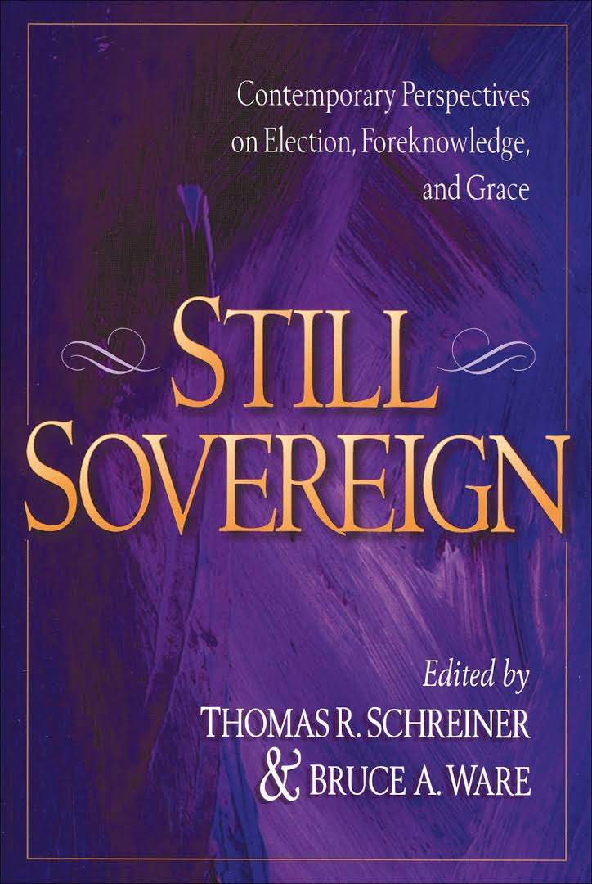
Why be Reformed?
Calvinism ought to be defended not because of its inherent logic, symmetry, or comprehensive structure per se, but because the substance of its biblical understanding is more compelling than that of its rivals.”
Bruce Ware, Still Sovereign, 204

Slide 6
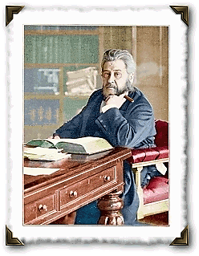
Why be Reformed?
“…what is the heresy of Arminianism but the addition of something to the work of the Redeemer? Every heresy, if brought to the touchstone, will discover itself here. I have my own private opinion that there is no such thing as preaching Christ and Him crucified, unless we preach what nowadays is called Calvinism. It is a nickname to call it Calvinism; Calvinism is the gospel, and nothing else”
Charles Spurgeon

Slide 7
What is Reformed Theology?
It’s Bigger Than You Might Think

Slide 8
Introduction: The Pillars of Reformed Theology
Covenant Theology
The five sola’s of the Reformation – Grace alone, Faith alone, Christ alone, Scripture alone, The Glory of God alone
The supremacy of God in all things
The doctrines of grace – Total depravity; Unconditional election; Limited atonement; Irresistible grace; Perseverance of the saints
A high view of the church and the sacraments
The Christian life as coram deo

Slide 9
Covenant Theology

Slide 10
Overview and summary
“The doctrine of the covenant lies at the root of all true theology. It has been said that he who well understands the distinction between the covenant of works and the covenant of grace, is a master of divinity. I am persuaded that most of the mistakes which men make concerning the doctrines of Scripture, are based upon fundamental errors with regard to the covenant of law and of grace. May God grant us now the power to instruct, and you the grace to receive instruction on this vital subject.”
C.H. Spurgeon

Slide 11
Overview and summary
“The term "covenant" is so closely associated with Reformed theology that the words "covenant" and "reformed" are often used interchangeably. In many circles, "Reformed theology" is "covenant theology"; "covenant theology" is "Reformed theology.“”
Covenant theology is the gospel set in the context of God’s eternal plan of communion with his people, and its historical outworking in the covenants of works and grace (as well as in the various progressive stages of the covenant of grace) (cf. Duncan; Packer)
“In Scripture “covenant” is the fixed form in which the relation of God to his people is depicted and presented.”
Herman Bavinck, Reformed Dogmatics: God and Creation.

Slide 12
Westminster Confession – 7.1-3
The distance between God and the creature is so great, that although reasonable creatures do owe obedience unto Him as their Creator, yet they could never have any fruition of Him as their blessedness and reward, but by some voluntary condescension on God's part, which He hath been pleased to express by way of covenant.
The first covenant made with man was a covenant of works, wherein life was promised to Adam; and in him to his posterity, upon condition of perfect and personal obedience.
Man, by his fall, having made himself incapable of life by that covenant, the Lord was pleased to make a second, commonly called the covenant of grace; wherein He freely offereth unto sinners life and salvation by Jesus Christ; requiring of them faith in Him, that they may be saved, and promising to give unto all those that are ordained unto eternal life His Holy Spirit, to make them willing and able to believe.

Slide 13
What is Covenant Theology?
It is a way of reading Scripture.
Yet, it is more than this; it is much, much more.
The Bible forces us to read it covenantally. How?
By the story it tells.
By the place it gives to Jesus in the covenant story.
By the specific parallel between Jesus and Adam in Romans 5:12-18; 1 Corinthians 15:21ff.
By the explicit declaring of the covenant of redemption in John’s gospel.

Slide 14
What is a covenant?
God reveals himself throughout the Scriptures as a covenant-making God: It is the life-embracing bedrock reality of the covenant relationship between the Creator / Redeemer and Christians.
Three aspects of God and our relationship to him we covenant forces us to recognize:
God is transcendent
God is immanent
We are qualitatively and quantitatively different
Definition - It is simply a legal arrangement between two parties, usually established with an oath and defined by divinely established sanctions.

Slide 15
Overview and Summary
A covenant typically includes these parts (cf. Deuteronomy as Suzerain-vassal treaty):
The parties involved (usually two);
Stipulations guiding the relationship between the one making the covenant and the one with whom the covenant is being made;
Sanctions for disobedience and blessings for obedience;
Some sort of bond is made between the two parties
There are only two ways in which a covenant may be treated by the parties – observation or violation.

Slide 16
Overview and Summary
Three basic types of covenant in Scripture:
Parity
Mutual compacts (cf. Genesis 20:14-18)
Royal Grant
Unilateral promises of gracious gift (cf. the Covenants of Grace with Noah, Abraham, David, Christ’s people)
Suzerain-vassal
Treaty of the Great King (cf. Adam; Mosaic)

Slide 17
Three Keys
There are three major covenants in Scripture:
Redemption
Works
Grace
These covenants are informed either by the basic principle of works or grace.
We must be aware of the covenants as we read Scripture.

Slide 18
Covenant of Redemption
The covenant of redemption is an eternal pact between the persons of the Trinity. The Father elects a people in the Son as their mediator to be brought to saving faith through the Spirit. (Horton)
There is an eternal agreement between the Father and the Son to save sinners (Ephesians 1:4; 3:11); the Son must obey the Father (John 10:18)
As a result of his obedience to that agreement, Christ has been given a people by the Father (cf. John 6:39; 10:29; 17:2, 4-10; Ephesians 1:4-12; Hebrews 2:13)
These people are the ones who are called and kept by the Holy Spirit for the consummation (Romans 8:29-30; Ephesians 1:11-13; Titus 3:5; 1 Peter 1:5)

Slide 19
Covenant of Works (or Creation)
“God’s pact with Adam in his integrity, as the head of the whole human race, by which God requiring of man the perfect obedience of the law of works promised him if obedient eternal life in heaven, but threatened him if he transgressed with eternal death; and on his part man promised perfect obedience to God’s requirement.
Heidegger 9, 15
Quoted in Heppe, Reformed Dogmatics

Slide 20
Covenant of Works
Though not overt, the substance of a covenantal arrangement is found in Genesis 1-3:
Adam is not simply an individual, he is a representative head (Romans 5:12ff)
The relationship between God and Man was established through divine words and acts of commitment.
Though “covenant” is not mentioned in the text of Genesis 1-3, the Scriptures later use this very language to describe that arrangement.
The relationship between the Covenant of Redemption and the Covenant of Works

Slide 21
The Covenants of grace
The covenants of grace include the covenants God made with post-Fall Adam, Noah, Abraham, Moses, David, and the New Covenant in Christ.
The most important implication of the covenant of grace is that there has always been only one way of salvation.
Yet there are differences in the administration of this covenant.

Slide 22
The Covenant of Grace: Abraham
In a series of revelations (Genesis 12-17) God promises three distinct blessings to Abraham: a royal heir, a great nation as his offspring, and a promised land.
It is essential to realize that each of these promises is fulfilled in two distinct stages, first according to type and finally according to fulfillment.

Slide 23
The Covenant of grace: Abraham and Moses
The Mosaic covenant is a typological republication of the covenant of works:
As the covenant of grace, under which the ancients were, is not to be confounded with, so neither is it to be separated from, the Sinaitic covenant: neither are we to think that believers were without all those things which were not promised by the Sinaitic covenant, and which the typical covenant, because of its weakness and unprofitableness, could not bestow; as they were likewise partakers of the Abrahamic covenant, which was a pure covenant of grace: and hence were derived the spiritual and saving benefits of the Israelites.
Herman Witsius

Slide 24
The Covenant of Grace: Moses
The apostle Paul often contrasts the Mosaic law (works) with the Abrahamic promise (grace). He assumes that these two principles are fundamentally opposed to one another: “For if the inheritance is based on law, it is no longer based on a promise” (Galatians 3:18)
The Mosaic Covenant is founded upon the Abrahamic promises.
But this covenant also functions on a typological level.
This covenant has been supplanted by the New covenant in Christ.
Relationship between the Covenants of Grace and the Covenant of Works

Slide 25
Covenants: Summary (cf. Horton)
There is covenantal unity in Scripture:
“Law” and “promise” characterize two different kinds of covenants that exist within the same history.
Old covenant believers are ‘saved’ by faith in the promise of Christ.

Slide 26
Covenants: Summary (cf. Horton)
There is covenantal disunity in Scripture:
The covenants with Adam after the Fall, as with Noah, Abraham, and David, represent unconditional divine oaths.
The suzerain covenant is constitutive of the pact made between God and Israel at Sinai through its successive cycles of violation, restoration, transgression and finally exile.
We must recognize fulfillment and obsolescence.
We cannot attain the everlasting promises of God through the covenant of law.
There is a distinction to be made between God’s people: by reception of promise and by birth.

Slide 27
Four Conclusions
The gospel is not properly understood until it is viewed within a covenantal framework.
The Word of God is not properly understood until it is viewed within a covenantal framework.
The reality of God is not properly understood until it is viewed within a covenantal framework.
Many key theological realities and their implications are not properly understood until they are viewed within a covenantal framework.

Slide 28
Implications for Reading Scripture
Historical-grammatical
Gospel-centered
Redemptive-historical
Scripture interprets Scripture
Pactum Salutis, Historia Salutis and Ordo Salutis
Application of Scripture – our inability; Christ’s all-sufficiency

Slide 29
The Covenant of Works
The first covenant made with man was a covenant of works, wherein life was promised to Adam; and in him to his posterity, upon condition of perfect and personal obedience. (WCF, 7, 2)
Parties – God and Adam (and his offspring)
Conditions – Do not eat of the tree of the knowledge of good and evil
Sanctions – “You shall surely die”
Promise – Eternal life
Sign – Tree of Life
How it is related to us – Original sin, imputation of Adam’s guilt

Slide 30
The Covenant of Redemption
Between God the Father and God the Son in their eternal council, the Son promising to redeem sinners in his blood, the Father promising to the Son a kingdom, glory and people.
Biblical Texts:
“Now may the God of peace who brought again from the dead our Lord Jesus, the great shepherd of the sheep, by the blood of the eternal covenant…” (Hebrew 13:20).
“Father,… I glorified you on earth, having accomplished the work that you gave me to do’” (John 17:4)
“Jesus said to them, ‘My food is to do the will of him who sent me and to accomplish his work” (John 4:34).
“All that the Father gives me will come to me… And this is the will of him who sent me, that I should lose nothing of all that he has given me” (John 6:37, 39).

Slide 31
The Covenant(s) of Grace
Man, by his fall, having made himself incapable of life by that covenant, the Lord was pleased to make a second [covenant], commonly called the covenant of grace. Wherein He freely offers unto sinners life and salvation by Jesus Christ; Requiring of them faith in Him, that they may be saved. And promising to give unto all those that are ordained unto eternal life His Holy Spirit, to make them willing, and able to believe. (WCF 7.3)
The covenant of grace is God’s way of reconciling sinners to himself.
Promised to Satan – Genesis 3:15
Symbolized to Adam and Eve – Genesis 3:21
Inaugurated in God’s covenant with Abraham – Genesis 12:2-3
Fulfilled by Christ – Luke 22:20

Slide 32
The 5 Solas

Slide 33
The 5 Solas
Sola Scriptura – Scripture Alone – The Bible as God’s word is the only test of what is true and good. There is no other source from which we can know about God, his plan, and his works.
Sola Gratia – Grace Alone – Redemption from the guilt of sin comes to an individual by God’s grace alone. No one is qualified by works or rituals, or by anything a human or church can do.
Soli Christi – By Christ Alone – It’s only through Christ that we are forgiven and restored to fellowship with God. He paid our debt in full, and clothes us with his perfect righteousness. We find our ability to honor God in the power of the risen and living Savior – and in him alone.
Sola Fide – Faith Alone – We embrace God’s promises by faith alone. God gives us confidence in his revealed promises and provisions so that we put our full trust him alone. We have no other object in which we put our trust regarding spiritual and eternal matters.
Sola Deo Gloria – For God’s Glory Alone – Everything should be done for God’s glory alone. All our thoughts, words, and work should be intended for the Glory of God.

Slide 34
The 5 solas
These 5 solas all stand together as the principles that define the gospel of Christ.
The evangelical problem is not with the noun, but with its descriptor.
"The essence of false Christianity is the denial that each of these stands alone. People freely talk about the Bible, Grace, Faith, Christ, and God’s glory. The problem many have is with the “sola” part. Only when these things standalone, is the gospel seen as what the Bible says it is, rather than what many wish it to be.“ (Burridge)

Slide 35
Sola Scriptura

Slide 36
Sola scriptura
Sola scriptura simply means that we don’t need any more words from God.
2 Timothy 3:12-4:5
Definition - the Scriptures alone are the ultimate authority in the life of the believer and the church. It alone is to be our standard and our foundation.
"Other sources of authority may have an important role to play. Some are even established by God such as the authority of church elders, the authority of the state, or the authority of parents over children. But Scripture alone is truly ultimate. Therefore, if any of these other authorities depart from Bible teaching, they are to be judged by the Bible and rejected." (James Montgomery Boice)

Slide 37
Sola scriptura
The whole counsel of God concerning all things necessary for his own glory, man’s salvation, faith and life, is either expressly set down in Scripture, or by good and necessary consequence may be deduced from Scripture: unto which nothing at any time is to be added, whether by new revelations of the Spirit, or traditions of men. Nevertheless, we acknowledge the inward illumination of the Spirit of God to be necessary for the saving understanding of such things as are revealed in the Word: and that there are some circumstances concerning the worship of God, and government of the church, common to human actions and societies, which are to be ordered by the light of nature, and Christian prudence, according to the general rules of the Word, which are always to be observed.
Westminster Confession, 1, 6

Slide 38
Sola scriptura: Implications
Implications:
Sufficiency - The Bible is the only infallible rule of what we are to believe and how we are to live.
Necessity - Scripture is "most necessary" because through it alone comes "that knowledge of God, and of his will, which is necessary unto salvation“
Inerrancy - The Bible is free from error as it sprung from God.
Clarity – The Bible is clear, though not easy, to understand

Slide 39
Sola Scriptura: Four clarifications
Sola scriptura is not the same as solo scriptura
“… some have used sola Scriptura as a justification for a “me, God, and the Bible” type of individualism, where the church bears no real authority and the history of the church is not considered when interpreting and applying Scripture. Thus, many churches today are almost ahistorical—cut off entirely from the rich traditions, creeds, and confessions of the church. . . The Reformers would not have recognized such a distortion as their doctrine of sola Scriptura. (Michael Kruger)

Slide 40
Sola Scriptura: Four clarifications
How does sola scriptura deal with tradition?
“To summarize the Reformation doctrine of sola Scriptura, or the Reformation doctrine of the relation between Scripture and tradition, we may say that Scripture is to be understood as the sole source of divine revelation; it is the only inspired, infallible, final, and authoritative norm of faith and practice. It is to be interpreted in and by the church; and it is to be interpreted within the hermeneutical context of the rule of faith.” (Keith Mathison)

Slide 41
Sola Scriptura: Four clarifications
Does God still speak alongside Scripture?
In essence this perspective is no different than the Catholic understanding of authority. But instead of tradition and Scripture being held as equal levels of authority, Scripture and the ‘speaking of God to me’ are equal levels of authority.
What about different interpretations? Doesn’t that destroy sola scriptura?
The Reformers believed that the corrective to multiple interpretations is to investigate the history of interpretation.

Slide 42
The Supremacy of God in ALL Things

Slide 43
Supremacy of God in All things
God has all life, glory, goodness, and blessedness in and of himself. He alone is all-sufficient in and unto himself, nor does he need any of his creations or derive any glory from them. Rather, he manifests his own glory in, by, unto, and on them. He is the only source of all being, by whom, through whom, and to whom everything exists. He has completely sovereign dominion over all things and does with, to, or for them whatever he pleases. Everything is revealed and completely open to him. His knowledge is infinite, infallible, and does not depend on any created being, so that to him nothing is conditional or uncertain. He is completely holy in all his purposes, works, and commands. To him is due whatever worship, service, or obedience he is pleased to require from angels, human beings, and all other creatures.
Westminster Confession, 2, 2

Slide 44
What do we mean by supremacy?
“Yours, O LORD, is the greatness and the power and the glory and the victory and the majesty, for all that is in the heavens and in the earth is yours. Yours is the kingdom, O LORD, and you are exalted above all. Both riches and honor come from you, and you rule over all. In your hand are power and might, and in your hand it is to make great and to give strength to all”
1 Chronicles 29:11-12
The sovereignty of God is his absolute, independent right of disposing of all creatures according to his own pleasure.
Jonathan Edwards

Slide 45
The supremacy of God in ALL things
This means:
God is under no external constraints of any kind as he relates to his creation
The only constraints he is under are his nature and will
God’s sovereignty applies to all things – including salvation
God is the creator and therefore the owner, possessor, and Lord of all things, apart from him there is no existence or ownership. He alone has absolute authority. Always and everywhere his will decides. . . That will is the final ground of all things, of their being, and of their being as they are.
Herman Bavinck, Reformed Dogmatics: God and Creation

Slide 46
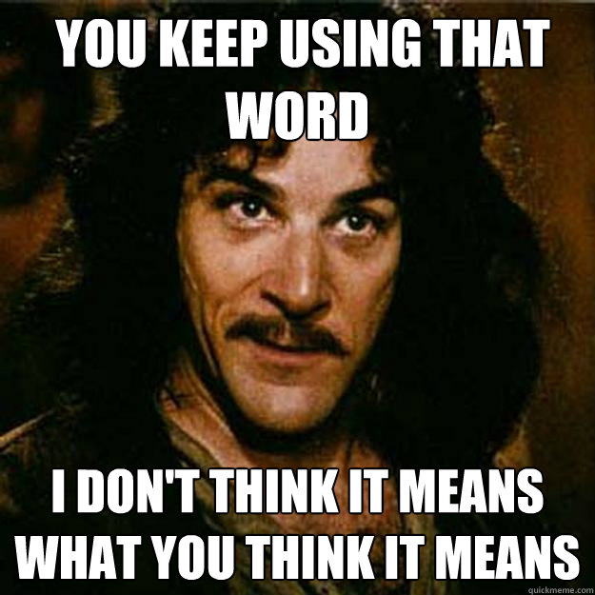
Not all agree…
Arminians:
The issue is NOT that God is in control, but how he exercises that control. (General vs. specific sovereignty)
God is in control of his directives; beyond that his control is (merely) permissive but not determinative.
“God may and no doubt sometimes does bring about some event by placing people in circumstances where he knows what they will freely do because he needs them to do that for his plan to be fulfilled.” (Olson)

Slide 47
Not All Agree…
Arminian theologian Roger Olson articulates what he calls “a relational view of God’s sovereignty”:
“a relational view of God’s sovereignty is one that regards God’s will as settled in terms of the intentions of his character but open and flexible in terms of the ways in which he acts because he allows himself to be acted upon. Only such a view of God’s sovereignty does justice to the whole of the biblical drama, to God as personal, to human persons as responsible actors and potential partners with God in God’s mission.”

Slide 48
The Supremacy of God in Salvation
Edwards – “it [God’s Sovereignty] implies that God can either bestow salvation on any of the children of men, or refuse it, without any prejudice to the glory of any of his attributes, except where he has been pleased to declare, that he will or will not bestow it.”
Three key texts in relating Gods supremacy in all things to salvation:
Ephesians 1
Romans 9
John 6

Slide 49
The Doctrines of Grace
TULIP

Slide 50
Overview
Total depravity – Radical corruption – Due to Adam’s sin, human nature is corrupt, and every person stands condemned in God’s sight. If God does not act directly upon an individual, that person has no hope of being saved.
Unconditional election – Sovereign election – God elects certain persons to be saved, based solely upon his determination, apart from anything the person may do or not do.
Limited atonement – Particular redemption – The full, saving work of Christ is directed specifically to the elect.
Irresistible grace – Effectual calling – God acts in grace upon the elect so that they are able to come to faith in him (regeneration). They do not resists this movement of the Spirit.
Perseverance of the Saints – Preservation of the Saints – God ensures that his people will remain his saved people throughout their lifetime.

Slide 51
Introduction
The Reformed understanding of salvation is NOT a product of an external system, nor is it attributed to only a few theologians, nor is it the implication of a narrow view of God, nor is it the result of a philosophical system, nor is it the result of over-emphasizing a few proof-texts.
It is, instead, a result of biblical realities, from Genesis to Revelation, properly understood.

Slide 52
introduction
These five points do not define for us what the Reformed Faith or Calvinism is. The Reformed Faith is a system of truth and is much more comprehensive than any five points that might be enumerated, however important in it or essential to it these five points might be. In these five points attacked by the Arminians, however, the system of truth known as Calvinism may said to be crystallized.
John Murray

Slide 53
Introduction
The key difference between a Calvinist and an Arminian is how they understand how we get saved; that is, how we move from a condition of spiritual unbelief to a condition of heartfelt belief or faith in Christ. And the key difference is this: Calvinists believe that God has to produce in us the decisive desire for Christ. And Arminians believe we must produce in ourselves the decisive desire for Christ. The Arminians say that God helps us. He helps all people, but we provide the last, decisive impetus and desire for that belief.
John Piper

Slide 54
Radical Corruption
aka. Total Depravity

Slide 55
Radical Corruption
Since Adam and Eve are the root of all mankind, the guilt for this sin has been imputed to all human beings, who are their natural descendants and have inherited the same death in sin and the same corrupt nature.
This original corruption completely disinclines, incapacitates, and turns us away from every good, while it completely inclines us to every evil. From it proceed all actualized sins.
Westminster Confession, 6.3-4

Slide 56
Radical Corruption: Overview
Man is spiritually dead. Because of the fall, man has become spiritually dead, blind and deaf to the things of God and is therefore unable of himself to choose spiritual good and determine his own destiny.
As Christopher Blum states, "Because man’s will is not free - for it is in bondage to his evil nature - he will never, and in fact can never, choose the goodness of God over the sinful desires of the flesh."
Thus we can never speak of man having "free will" since it is always in bondage to sin apart from salvation in Christ.

Slide 57
Radical corruption
This doctrine is agreed upon by both Arminians and the Reformed alike:
Article III of the Remonstrance, 1610
Roger Olson, “With Calvinists I can affirm that we are all spiritually dead apart from supernatural grace…”
John Wesley, "I believe that Adam, before his fall, had such freedom of will, that he might choose either good or evil; but that, since the fall, no child of man has a natural power to choose anything that is truly good. Yet I know (and who does not?) that man has still freedom of will in things of indifferent nature”

Slide 58
Radical corruption
Pervasive depravity means that: [Anthony Hoekema, Created In God’s Image]
The corruption of original sin extends to every aspect of human nature: to one’s reason and will as well as to one’s appetites and impulses; and,
There is not present in man by nature love to God as a motivating principle of his life.

Slide 59
Radical corruption
This doctrine does NOT mean that:
The unregenerate person is totally hardened to matters of the conscience (matters of right and wrong);
The sinful person is as sinful as possible - there are genuine benevolent unregenerate people who show better ‘fruit’ than some believers do;
The unregenerate person is unable to perform certain actions that are good and helpful in the sight of others;
The sinner engages in every possible sin.

Slide 60
Radical Corruption
Sin is a matter of the whole person
The unregenerate person’s good acts always contain an element of sinfulness
Sinners are completely unable to do anything about their sinful condition
There are a plethora of biblical pictures that affirm this corruption:
spiritual blindness and darkness (Ephesians 4:18);
spiritual death (Ephesians 2:1-2, 5; Colossians 2:13);
slavery to sin (Romans 6:20);
polluted or corrupted (Psalm 51, 58)
Our rebellion is totally deserving of eternal punishment

Slide 61
Excursus: Free Will & depravity
The case of Jerry and Ed
Does the Bible teach that people have the power and initiative within their own will to believe the gospel?
The question is NOT, “Are people morally responsible for their actions?”
The question is also NOT, “Do people have the opportunity to believe?”
The question, rather, is this: “Do people have a free and unfettered will by which they are able to believe?”

Slide 62
Excursus: Free Will & depravity
Total depravity means that no matter how “civil” or “compassionate” or “industrious” or “law-abiding” someone might otherwise be in his dealings with other people, he is utterly and willfully loath to all that Christ is and says.
What this means in terms of the gospel is that left to himself a person will invariably, inevitably, and without pause reject the truth.
“I might borrow the eloquence of Demosthenes or of Cicero, but ye will not come unto Christ. I might beg of you on my knees, with tears in my eyes, and show you the horrors of hell and the joys of heaven, the sufficiency of Christ, and your own lost condition, but you would none of you come unto Christ of yourselves unless the Spirit that rested on Christ should draw you. It is true of all men in their natural condition that they will not come unto Christ” (Charles Spurgeon)

Slide 63
Excursus: Free Will & depravity
What, then, of human freedom?
It means we have free agency but not free will (compatibilism)
Free agency – the ability to act according to one’s desires and inclinations without being compelled to do otherwise by something or someone external.
Free will – our will is the extension and invariable expression of his nature. As he is, so he wills. A man is therefore not free to act or to will or to choose contrary to his nature.

Slide 64
What is Reformed Theology?
It’s Bigger Than You Might Think
© 2017 Jared Hiebert

Slide 65
Sovereign Election
aka. Unconditional Election

Slide 66
Sovereign election
From all eternity and by the completely wise and holy purpose of his own will, God has freely and unchangeably ordained whatever happens. This ordainment does not mean, however, that God is the author of sin (he is not), that he represses the will of his created beings, or that he takes away the freedom or contingency of secondary causes. Rather, the will of created beings and the freedom and contingency of secondary causes are established by him.
Although God knows whatever may or can happen under all possible circumstances, he has not ordered anything because he foresaw it in the future as something which would happen under such circumstances.
Westminster Confession, 3.1-2

Slide 67
Sovereign election
Before the creation of the world, according to his eternal, unchangeable plan and the hidden purpose and good pleasure of his will, God has chosen in Christ those of mankind who are predestined to life and to everlasting glory. He has done this solely out of his own mercy and love and completely to the praise of his wonderful grace.
According to the hidden purpose of his own will, by which he offers or withholds mercy at his pleasure, and for the glory of his sovereign power over his creatures, it pleased God not to call the rest of mankind and to ordain them to dishonor and wrath for their sin to the praise of his glorious justice.
Westminster Confession, 3.5, 7

Slide 68
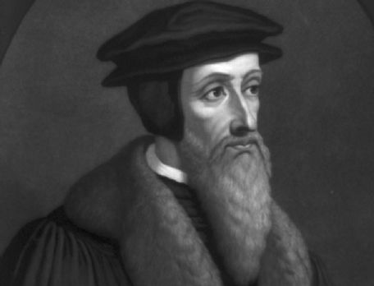
Sovereign Election
“It is better to limp along this path than to rush with all speed outside it.”
John Calvin
Institutes 1.6.3

Slide 69
Sovereign election
Essentially there are three options:
God elects those who are good.
God elects some who are bad, but he elects them since they have exercised faith in Christ. This is Arminianism.
God elects some who are bad, and who are not able to save themselves. Thus his election is according to his sovereign good pleasure alone. This is Reformed.

Slide 70
Sovereign election
The question reduces to this: Does God elect people because they believe in the Lord Jesus Christ, or does God elect people in order that they shall believe in Christ? (cf. Storms)
Or to put it even more simply:
The Calvinist says that God elects unbelievers and predestines them to become believers.
The Arminian says that God elects believers and predestines them to become his children.

Slide 71
Sovereign Election: Overview
God's election is unconditional. God's choice of certain individuals for salvation was not based on any foreseen response of obedience, future faith, repentance or any other action.
From eternity past, God the Father chose certain individuals from every tongue, tribe, nation and generation of humanity to redeem - the elect - and passed over the rest of mankind - the reprobate.
Thus God’s choice of who he would save was rooted entirely in His sovereign, transcendent, perfect will, the nature or specifics of which the Bible leaves as a complete mystery to us. No one deserves salvation, since "all have sinned and fallen short of the glory of God" (Romans 3:23).
Salvation is, therefore, entirely of God's grace to save some out of the mass of perdition.

Slide 72
Sovereign Election
Aspects of divine election that are key to understand:
It is God's choice alone - he saves whomever he pleases according to his own will and for his own purposes.
It is an unconditional choosing - God's choice of who will be saved rests on his sovereign decision alone - it lacks external conditions (such as an act of faith seen in the future).
Election is monergistic (God alone is responsible for our salvation)

Slide 73
Sovereign Election
Romans 9 - "Though they were not yet born and had done nothing either good or bad, in order that God’s purpose of election might continue not because of works but because of his call, she was told, “The elder will serve the younger.” As it is written, “Jacob I loved, but Esau I hated.”" (vv. 11–13)
Ephesians 1:3-14 - “He chose us in him before the foundation of the world that we should be holy and blameless before him. He destined us in love to be his sons through Jesus Christ, according to the purpose of his will, to the praise of his glorious grace.” (vv.4–6); “We who first hoped in Christ have been destined and appointed to live for the praise of his glory” (v. 12).
2 Thessalonians 2:13 - “We are bound to give thanks to God always for you, brethren beloved by the Lord, because God chose you from the beginning to be saved through sanctification by the Spirit and belief in the truth”

Slide 74
Sovereign Election
2 Timothy 1:9 - God is the one “who saved us and called us with a holy calling, not in virtue of our works but in virtue of his own purpose and the grace which he gave us in Christ Jesus ages ago.”
Revelation 13:7 - “And authority was given it over every tribe and people and tongue and nation, and all who dwell on earth will worship it, every one whose name has not been written before the foundation of the world in the book of life of the Lamb that was slain.”
Revelation 17:8 - “The dwellers on earth whose names have not been written in the book of life from the foundation of the world will marvel to behold the beast, because it was and is not and is to come.”

Slide 75
Sovereign Election: Objections
Why wouldn’t God save everyone if he has the power to do so?
Romans 8:29, "For those whom he foreknew he also predestined to be conformed to the image of his Son." Does this not suggest that God's election is a result of seeing our faith?
Election is fatalistic / mechanistic; it makes people into robots who simply do what they were eternally programmed to do.
If everything is fixed and certain, why pray, evangelize, or do anything at all?
Election is not fair!
If election is true, then there are unbelievers who die in sin who never had a chance to believe.
The Bible says that God wills to save everyone.

Slide 76
Particular Redemption
aka. Limited Atonement

Slide 77
Particular redemption
Christ insures with absolute certainty that everyone for whom he purchased redemption actually accepts and receives it. He makes intercession for them, reveals the mysteries of salvation to them in and by the word, and effectively persuades them to believe and obey by his Spirit. He governs their hearts by his word and Spirit and overcomes all their enemies by his almighty power and wisdom in such ways as are most in agreement with his wonderful and unknowable administration of things.
Westminster Confession, 8, 8

Slide 78
Particular Redemption: Overview
Christ's death was designed to actually secure the salvation of all of God's chosen people, rather than merely make it possible. God has determined that all for whom Christ sacrificed Himself will be saved.
To put it in a slightly different way, “not only was Christ’s Atonement designed for, and given to, only the elect; it also actually secured salvation for them, and purchased all the means to such, including their faith and repentance, thereby guaranteeing their salvation. Thus, the Atonement did not merely offer its objects the opportunity to be redeemed, but it wholly and effectively redeemed them!” (Christopher Blum)

Slide 79
Particular redemption
Here are the options:
If Christ’s death actually saved all men from all of their sins you have universalism.
If Christ died to save some of the sins of some men, then Christ did not accomplish their salvation and thus did not save them at all. He merely made them savable. This is the Arminian perspective.
If Christ's death actually saved men from their sin, then his death cannot apply to all men.

Slide 80
Particular redemption
The restrictive manner in which Scripture speaks.
The distinguishing language of how Scripture speaks of the saved.
The redemption obtained by Christ is restricted to those who were “chosen in him,” and whom the Father gave to him to redeem by his death. (Ephesians 1:4, 7; John 17:2)
The intention of Christ in laying down his life was, not merely to obtain for those for whom he died a possibility of salvation, but actually to save them.
The intercession of Christ proceeds upon the ground of his atoning sacrifice. (John 17:9; 1 John 2:1, 2)

Slide 81
Particular redemption: Objections
2 Timothy 2:3-6 - “For this is good and acceptable in the sight of God our Savior, who desires all men to be saved and to come to the knowledge of the truth. For there is one God and one Mediator between God and men, the Man Christ Jesus, who gave Himself a ransom for all, to be testified in due time.”
2 Peter 3:9 - “The Lord is not slack concerning His promise, as some count slackness, but is longsuffering toward us, not willing that any should perish, but that all should come to repentance.”
To these we could add John 3:16, 4:42; 1 John 2:2 – the “world” texts.

Slide 82
Particular redemption
Conclusion:
"Scripture teaches that Jesus did not fail. Rather where Adam failed, Jesus succeeded. As the Second Adam (Rom 5:14; 1 Cor. 15:22, 44) Jesus actively obeyed God’s perfect Law perfectly, and suffered all the wrath which was due to us, his people, for whom he died (Phil 2:5–11).“
R. Scott Clark

Slide 83
Effectual Calling
aka. Irresistible Grace

Slide 84
Effectual calling
At the right time, appointed by him, God effectually calls all those and only those whom he has predestined to life. He calls them by his word and Spirit out of their natural state of sin and death into grace and salvation through Jesus Christ… But they come to Jesus voluntarily, having been made willing by God’s grace.
This effectual call is freely made by God and is entirely an act of his special grace. It does not depend on anything God foreknew or foresaw about the person called, who is completely passive. God himself gives life and renewal by the Holy Spirit. He thereby enables each person to answer his call and to accept the grace he offers and actually gives.
Westminster Confession, 10, 1, 2

Slide 85
Effectual calling: Overview
When the external call to salvation is made through gospel proclamation, the Holy Spirit extends a special inward call to the elect people that God wishes to save at that particular time and regenerates them.
This regeneration creates within them a new heart and enables them to freely and willingly believe in Christ as Saviour and Lord. The new birth precedes and makes possible saving faith.
In drawing his elect to himself, God does not force people "against their will, squealing and kicking as it were" to believe in him. (Carson)
This doctrine emphasizes that "it is God’s choice of the sinner, and not the sinner’s of God, that ultimately and fully causes salvation, since the sinner’s very willingness to put faith in Christ is solely a gift from God that was purchased at the Cross" (Christopher Blum)

Slide 86
Effectual calling
The doctrine of irresistible grace DOES NOT mean that every influence of the Holy Spirit cannot be resisted.
It does mean that the Holy Spirit can overcome all resistance and make his influence irresistible.
Key passages:
John 6
2 Timothy 2:24-25
1 Corinthians 1:23-24
2 Corinthians 4:4-6

Slide 87
Effectual calling: Objections
"Yes, the Holy Spirit must draw us to God, but we can use our freedom to resist or accept that drawing."
God draws all men, not just some.
What about the passages that speak of people who resist the Holy Spirit? Doesn’t this imply that people can successfully resist God’s grace?

Slide 88
Preservation of the Saints
aka. Perseverance of the Saints

Slide 89
Preservation of the saints
Those whom God has accepted in his Son and has effectually called and sanctified by his Spirit can never completely or finally fall out of their state of grace. Rather, they shall definitely continue in that state to the end and are eternally saved.
This endurance of the saints does not depend on their own free will but on God’s unchangeable decree of election, flowing from his voluntary, unchangeable love. It also depends on the effectiveness of the merit and intercession of Jesus Christ, on the indwelling Spirit and indwelling seed of God in the saints, and on the nature of the covenant of grace. All these establish the certainty and infallibility of their preservation.
Westminster Confession, 17, 1-2

Slide 90
Preservation of the saints: Overview
All who are chosen by God, redeemed by Christ, and regenerated by the Holy Spirit are eternally saved. They are kept in faith by the power of God and therefore continue to persevere in faith.
Once the Holy Spirit regenerates people, and they place their trust in Christ, they are eternally kept in their state of salvation by God. He faithfully preserves all whom He set out to save and drew to him.
Likewise, whenever anyone apparently “receives Christ,” but later falls away and dies in that state, they were never truly saved at all - for anyone whom the Holy Spirit calls was predestined by the Father and atoned for by the Son, and thus is sealed with God’s promise of eternal life.

Slide 91
Preservation of the saints
Our faith, and our obedience, must endure to the end if we are to be saved.
God’s elect cannot be lost.
If there is a persistent falling away of a believer, it shows they were never truly saved.
It is the work of God that causes his elect to persevere.
We need to be zealous to “confirm our calling and election.”

Slide 92
Preservation of the Saints
What would it mean if a true believer could fall away?
For God the Father:
He would not be worthy of glory nor of our praise and worship
His purpose in redemption would fail and unravel
His will would be frustrated and fail in fulfillment
It would mean the Father has refused to answer the prayers of his Son
God, supposedly all-powerful, would be exposed as impotent and helpless
God, supposedly righteous, would be exposed as a liar and an imposter
God would prove to be faithless

Slide 93
Preservation of the Saints
For God the Son:
Christ will have failed in the purpose for which He died
Christ will have failed in the purpose for which He was raised
Christ will have failed in the purpose for which He now intercedes in the presence of the Father
Christ will fail to accomplish the goal for which He is to return to this earth
Christ will prove to have been a liar

Slide 94
Preservation of the Saints
For God the Holy Spirit:
The Holy Spirit will have failed in his work of sealing
The Holy Spirit will have failed in his ministry as a pledge of the future consummation of our redemption
The Holy Spirit will have failed in his ministry as first fruits

Slide 95
Preservation of the saints: objections
Once people are saved, it doesn’t matter how they live – they are still guaranteed heaven.
God’s people can have no assurance of salvation until after they have persevered.

Slide 96
Answering Misconceptions

Slide 97
Answering Misconceptions
Reformed theology says that people are robots and do not have free will.
If people are elect there is no reason to witness.
If God elects only some to salvation, he is an unloving and unfair God.
The belief that salvation cannot be lost undermines the pursuit of continued holiness.
Election is a violation of free will; thus God can potentially drag people into heaven that don't want to be there, and reject those who do.

Slide 98
Reformed Theology & Arminianism Compared

Slide 99
Reformed Theology & Arminianism
According to Arminianism:
Salvation is accomplished through the combined efforts of God (who takes the initiative) and man (who must respond) - man's response being the determining factor. God has provided salvation for everyone, but his provision becomes effective only for those who, of their own free will, "choose" to cooperate with him and accept his offer of grace. At the crucial point, man's will plays a decisive role; thus man, not God, determines who will be recipients of the gift of salvation.
According to Calvinism:
Salvation is accomplished by the almighty power God. The Father chose a people, the Son died for them, the Holy Spirit makes Christ's death effective by bringing the elect to faith and repentance, thereby causing them to willingly obey the gospel. The entire process (election, redemption, regeneration) is the work of God and is by grace alone. Thus God, not man, determines who will be the recipients of the gift of salvation.

Slide 100
Reformed Theology & Arminianism
Reformed / Monergism
Arminianism / Synergism
Total depravity
Unconditional election
Limited atonement
Irresistible grace
Perseverance of the saints
Total depravity cancelled by prevenient grace; free will determinative
Conditional election (our choice as seen by God’s foreknowledge)
Limited atonement (efficacy)
Resistible grace (free will determinative
Salvation can be lost

Slide 101
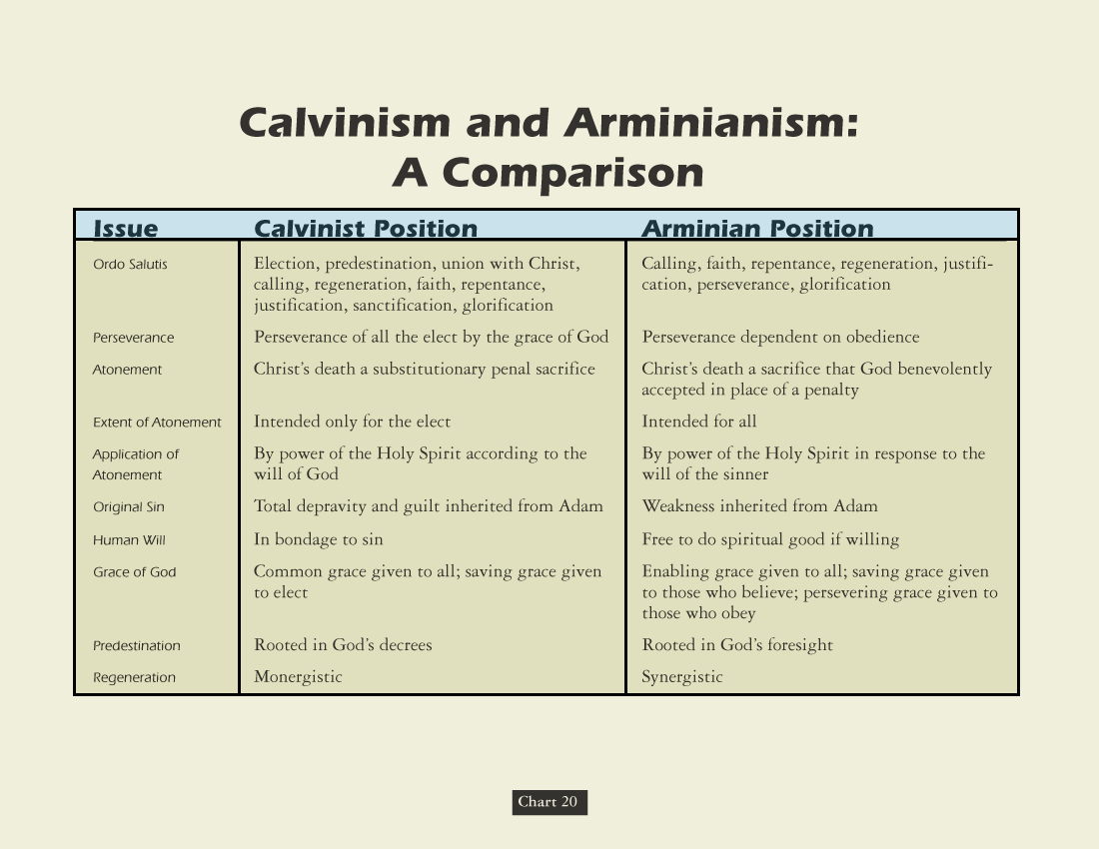

Slide 102
A High View of the Church

Slide 103
A High View of the Church
If we hold Christ as precious, the church must be precious. We are drawn together by Christ. We regard our assembling together, too, as precious.
The marks of the church are three, which correspond to the offices of Christ as he dwells among his people:
Preaching – the prophetic office
Sacraments – the priestly office
Discipline – the kingly office
Worship is governed by God’s word

Slide 104
High View of the Church
Reformed piety moves in the opposite direction of typical North American spirituality: from the public means of grace to the family to the individual, then to the World.
God
Church
Family / Individual
World

Slide 105
Implications for Understanding the Church
Reformed theology is NOT separation theology.
Reformed theology is NOT replacement theology.
Reformed theology is “unity theology” (Pratt Jr.)
There is no distinction made in the invisible church between ethnic Israel and the church.
Stress is placed on the unity between the visible communities of God’s people in the Old and New Testaments.
The New Testament visible church includes both believers and unbelievers, just as Old Testament Israel did.
Emphasizes the unity of Israel and the church by applying Old Testament remnant theology to the church.

Slide 106
Excursus
Why we are Credo-Baptists and not Paedo-Baptists

Slide 107
Why PaedoBaptism?
The primary argument comes from the relationship between Old Testament circumcision and New Testament baptism and its application within the visible church.
Christian baptism, so goes the paedo-baptist argument, is the New Testament counterpart to Old Testament circumcision.
Infant baptism does not guarantee the salvation of the infant, but sets them apart as children of covenant parents who are thus included in the external blessings and responsibilities of the people of God.
Colossians 2:11-12 is their main text.

Slide 108
Why NOT PaedoBaptism?
There are no explicit instances of infant baptism in Scripture.
Baptism is portrayed in the New Testament as a symbol of the beginning of spiritual life. – Galatians 3:27; Romans 6:3-4; Colossians 2:12
Baptism is consistently portrayed as inextricably tied to (conscious) faith and repentance. – Acts 2:38, 41; 8:12-13, 36; 10:47-48
In all the examples of “household” baptisms the broader contexts make clear that only “believers” were baptized.
When the New Testament church debated in Acts 15 whether circumcision should still be required of believers as part of becoming a Christian, it is surprising that not once in that debate did anyone say anything about baptism standing in the place of circumcision.

Slide 109
Why NOT PaedoBaptism?
We must take into account the nature of the New Covenant inaugurated by the death and resurrection of Jesus and one significant way in which it differs from the covenant God made with Abraham.
We must understand the differences between the new covenant people called the Church and the old covenant people called Israel.
The paedobaptist understanding of sacrament, which is biblically correct, runs contrary to their practice of baptism.
Paedobaptist definitions of baptism run contrary to their practice of baptism.
I can’t help but notice the absence in the New Testament of any explicit portrayal of an infant being baptized.

Slide 110
How Can We All Get Along?
A number of Reformed denominations would consider us to be a false church on account of our view and practice of baptism.
However, we would not return the ‘favor’. Why not?
“When I weigh the kind of imperfection involved in tolerating an invalid baptism because some of our members are deeply persuaded that it is biblically valid, over against the kind of imperfection involved in saying to a son or daughter of the living God, “You are excluded from the local church,” my biblical sense is that the latter is more unthinkable than the former. The local church is a visible expression of the invisible, universal, body of Christ. To exclude from it is virtually the same as excommunication. And no serious church takes excommunication as an invitation to attend the church down the street.”
John Piper

Slide 111
The Christian Life as coram deo

Slide 112
Life Coram Deo
Coram Deo = Before God
Starts with a true experience of the gospel - conviction of sin, cleansing by the sacrifice of Christ and glad response to his call to serve him.
We have been delivered from the bondage of law-breaking to enjoy the freedom of law-keeping.
The ‘cultural mandate’ (Genesis 1:28) still applies to us. This means witnessing, in word and life, to Christ’s Lordship over all things.

